Slide 1
Alternative Energy
Brent Gullett
Jerry Carpenter
Kelsey Bradley

Slide 2
Wonder Power
Wonder Power is an alternative energy source that will revolutionize vehicles.
In essence, Wonder Power is wind converted into electricity. The front spoiler (air dam) on vehicles will have ducts that will channel air to a wind turbine mounted on the firewall. The power created by the turbine will be stored in a battery bank.

Slide 3
The Problem-Solving Process
We used this process because it was a
simple and easy to design!
Step 1: State the problem clearly.
Step 2: Collect information.
Step 3: Develop possible solutions.
Step 4: Select the best solution.
Step 5: Implement the solution.
Step 6: Evaluate the solution.

Slide 4
Air Dam

Slide 5
Wind Turbine

Slide 6
Battery Bank

Slide 7
Wonder Power can also be used for conventional household items. The battery bank is connected to an inverter, which converts the power to 110V AC.

Slide 8
Ever gone camping and wake up wanting coffee? Now you can with Wonder Power!

Slide 9
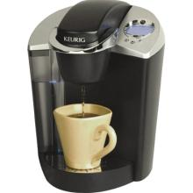
Simply just plug into your Wonder Power outlet!

Slide 10
Is your cordless drill or saw not charged and you need it right when you get to work! Don’t Worry! Wonder Power is here!

Slide 11
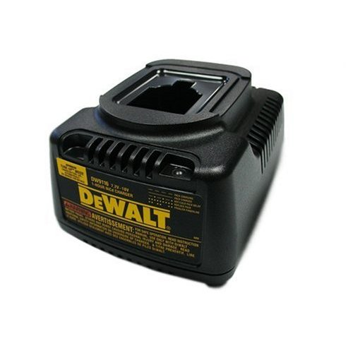
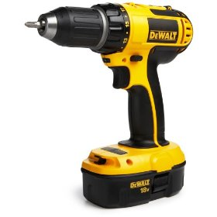
With Wonder Power, just plug in your charger to a Wonder Power outlet and charge it while you’re on your way to work!

Slide 12
Have you ever gotten a flat tire at night and not have any lights! Don’t worry! Wonder Power is here!

Slide 13
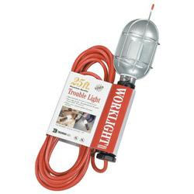
Just simply hook up the extension cord to your nearby Wonder Power outlet and BAM!! Lights appear!

Slide 14
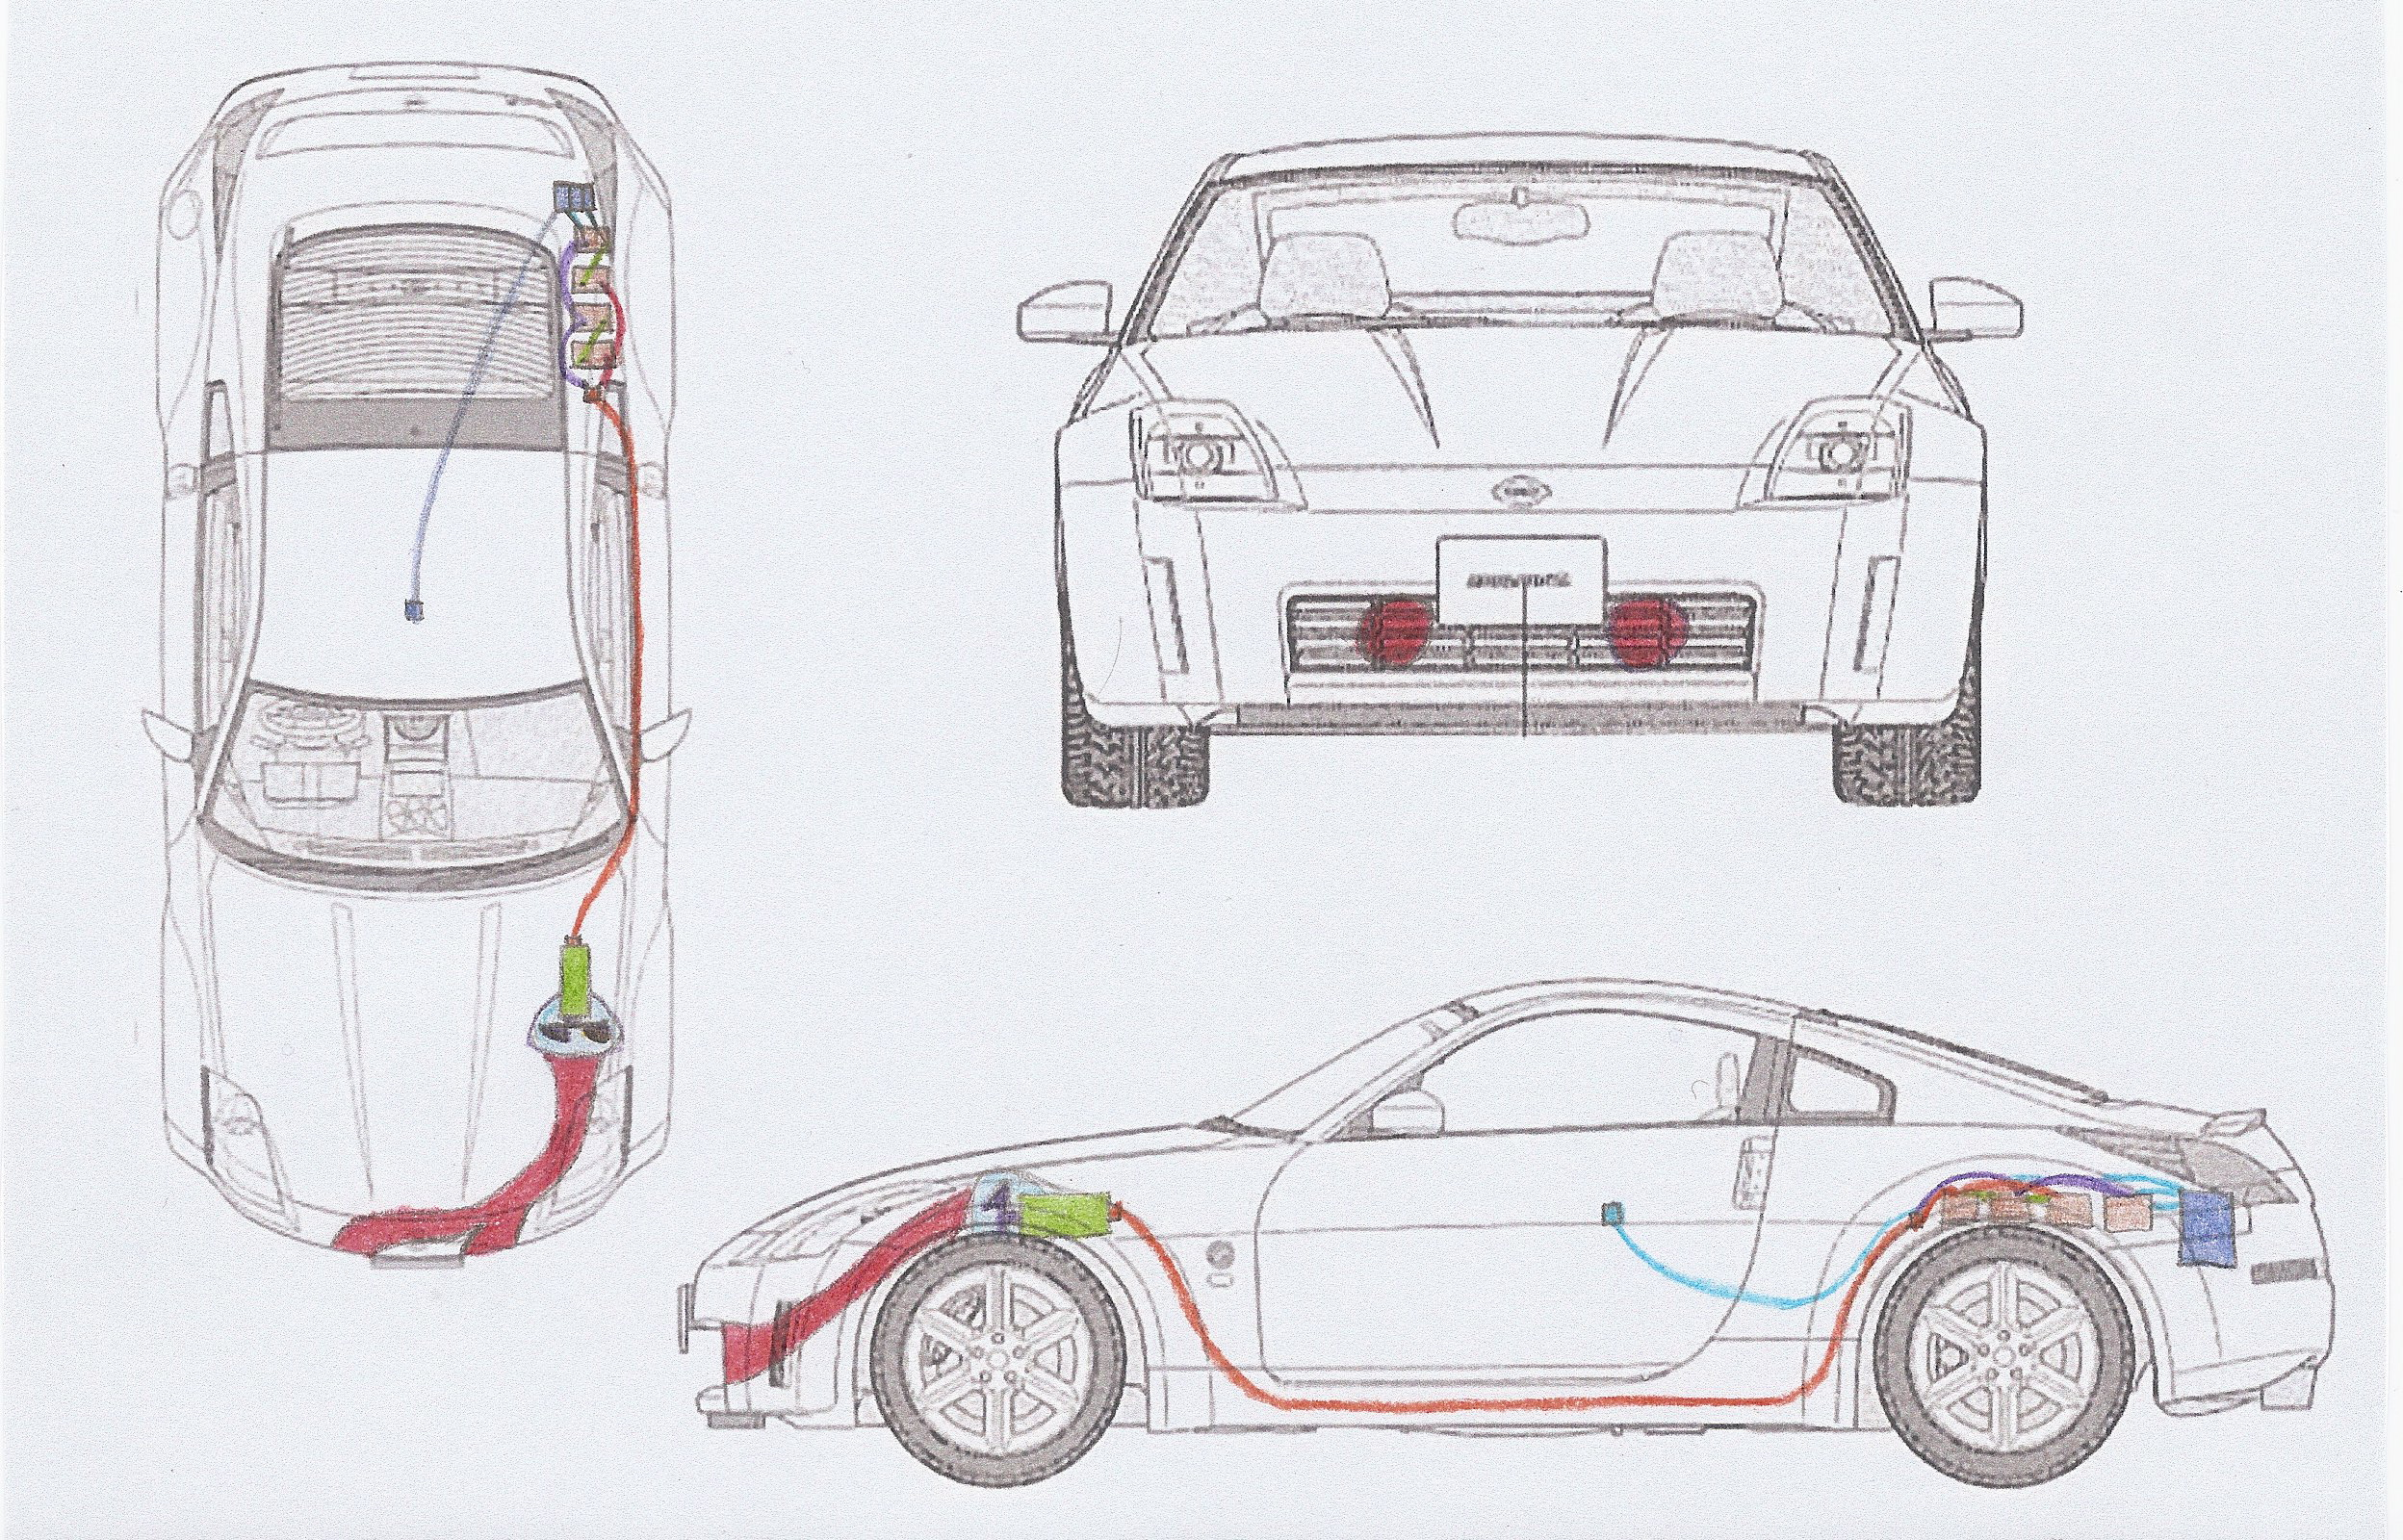
Wonder Power!

Slide 15
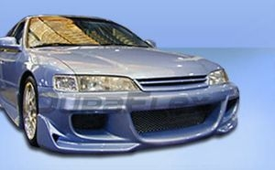

Slide 16
