Slide 1
Activity 4
Brent Gullett
Jerry Carpenter
Kelsey Bradley

Slide 2
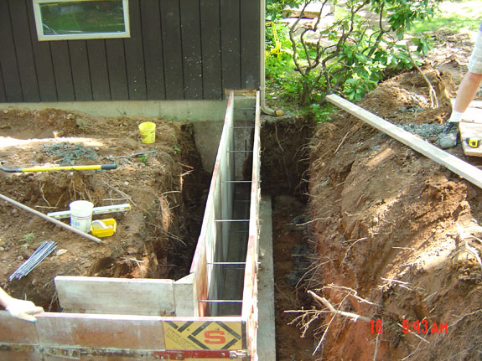
Concrete
Footer/Footer Wall $3,610
Footer Pads $190
Footer Column $95

Slide 3
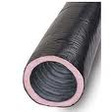
Rebar/Vap0r Barrier/anchor bolts
Vapor Barrier 6 rolls $360
Rebar #5, 1154 li. ft. $404
Anchor Bolts 45 bolts $15

Slide 4
Rough lumber
Band Board 360 Bd. Ft. $360
Sill Plate 136 Bd. Ft. $272
Floor Joist 3040 Bd. Ft. $6,080
Sole Plate 180 Bd. Ft. $360
Double Plate 360 Bd. Ft. $720
Studs 1800 Bd. Ft. $3,600

Slide 5
Subflooring/Interior Walls
Subflooring 4’x8’x1” 63 qty. $1,701
Interior Walls 170 Bd. Ft. $340

Slide 6
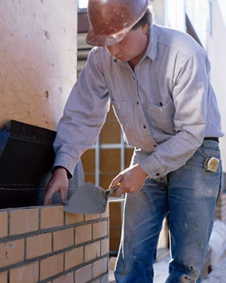
Brick/mortar
Brick 16,380 qty. $7,380
Mortar 250 bags/80 lb. $3,000

Slide 7
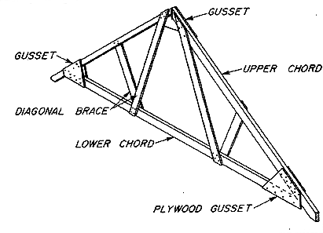
Trusses/sheathing
Trusses 26 qty $4,550
Side Sheathing 4’x8’x3/4” $2,160
Roof Sheathing 4’x8’x3/4” $2,214

Slide 8
Insulation
Wall 44 rolls $374
Ceiling 10 bags $300
Floor 45 bags $450
Interior 58 rolls $6,800

Slide 9
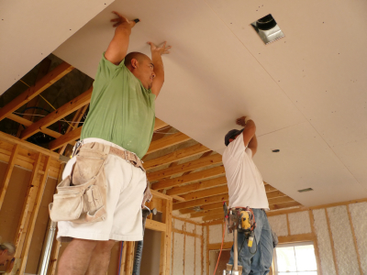
Gypsum board
Drywall 160 qty $1,120

Slide 10
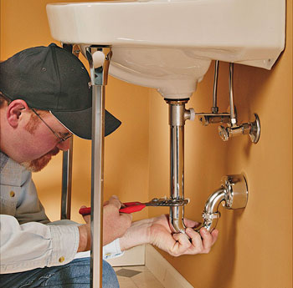
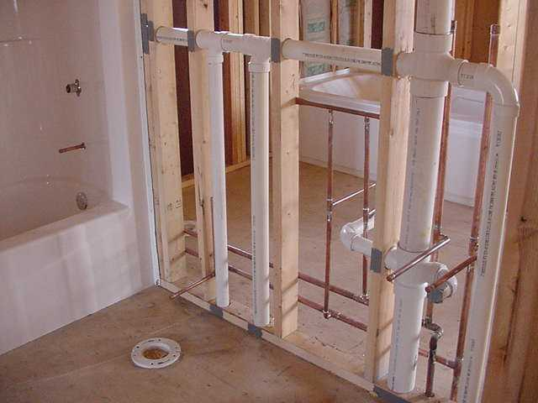
Wiring/plumbing
Electric $3,300
Plumbing $4,500

Slide 11
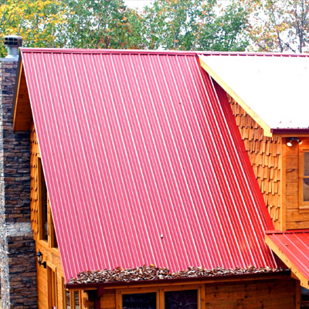
Roof/Drip edge/termite shield
Metal Roof $8,500
Drip Edge $72
Termite Shield $4.50

Slide 12
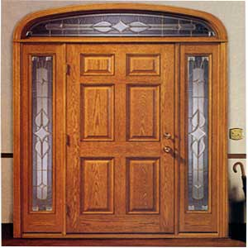
Trim/doors/windows
Trim $6,800
Doors $5,900
Windows $7,200
Paint $2,100

Slide 13
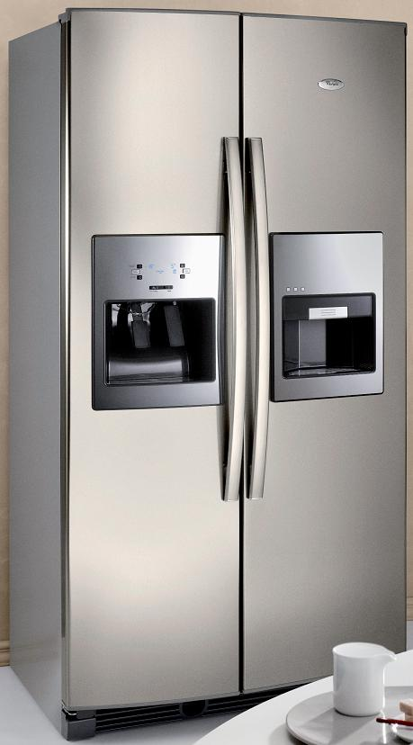
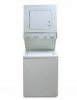
Appliances/Furniture
Appliances $41,500
Furniture $43,800

Slide 14
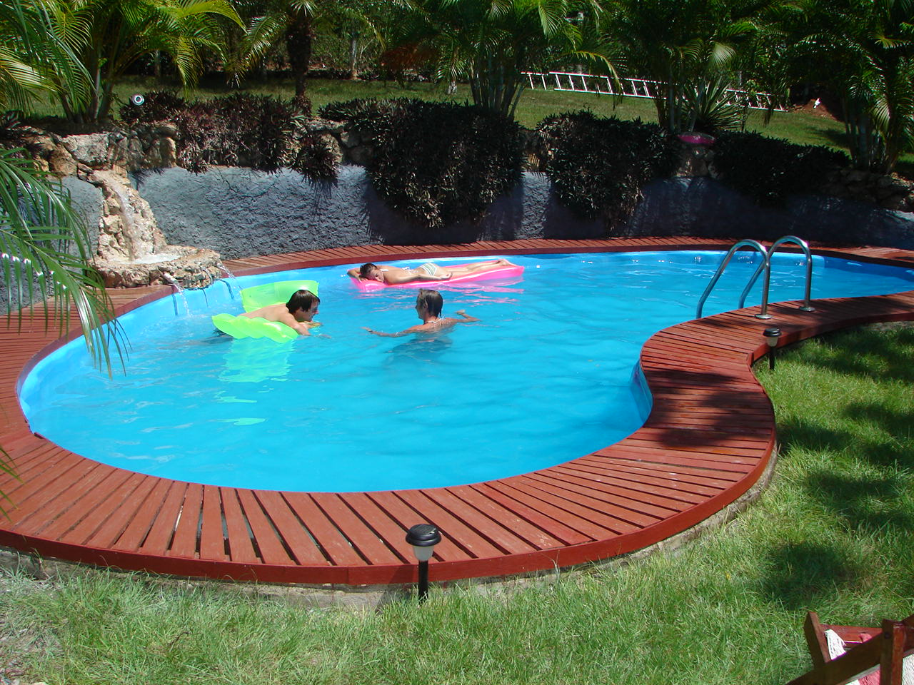
Swimming Pool
Swimming Pool $45,000

Slide 15
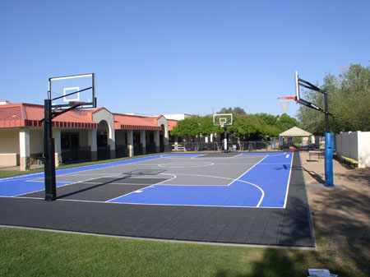
Outside basketball/volleyball court
Basketball Court $33,000

Slide 16
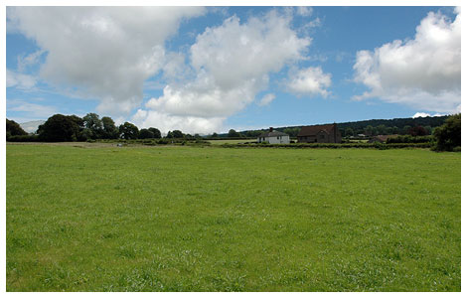
Land
Land 5 acres $25,000

Slide 17
Total price
Land $25,000
Materials $59,811
Labor $60,000
Furnishings $185,300
Total $330,111

