Slide 1
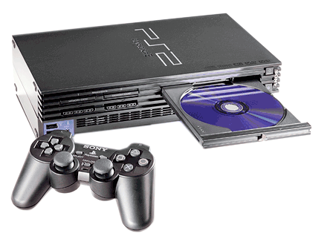
Engineering Design Process
by: Kelsey Bradley

Slide 2
Process
State the problem clearly
Collect information
Develop possible solutions
Select the best solution
Implement the solution
Evaluate the solution

Slide 3
Problem
My PlayStation 2 will come on, but it will rarely play the video game.

Slide 4
Solutions
Buy a new PlayStation 2
Borrow my brother’s PlayStation 2
Take apart my PlayStation 2 and attempt to fix it myself

Slide 5
Best Solution
I chose to take apart my PlayStation 2 and attempt to fix it myself. This was the cheapest solution and I knew that if for some reason I broke it I could always borrow my brother’s until I could purchase a new one.

Slide 6
Implementation
I took apart the PlayStation 2 and cleaned the inside with Isopropyl Alcohol (70%) and Q-tips.

Slide 7
Evaluation
This was the best solution because it worked. I now can play all of my games and not have to worry about them not coming on. This solution saved me money and kept me from having to borrow my little brother’s PlayStation 2.

