Slide 1
Exam 2 Review
Sanjeev Adhikari

Slide 2
Two parts
Multiple choice
Drawing by A+CAD

Slide 3
Let us review lab

Slide 4
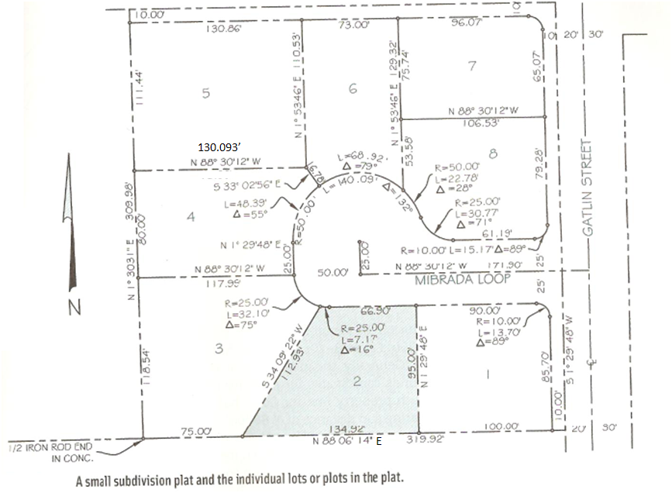
Assignment 4

Slide 5
Assignment 5
Drawing by carlson
Find area, bearing arc etc..

Slide 6
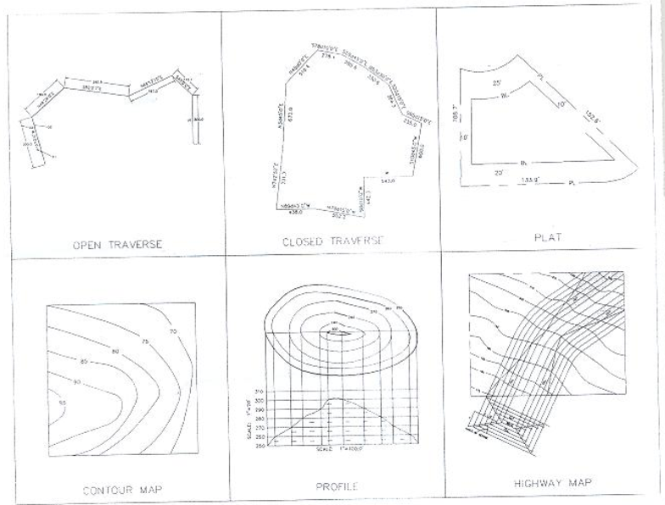
Assignment 6

Slide 7
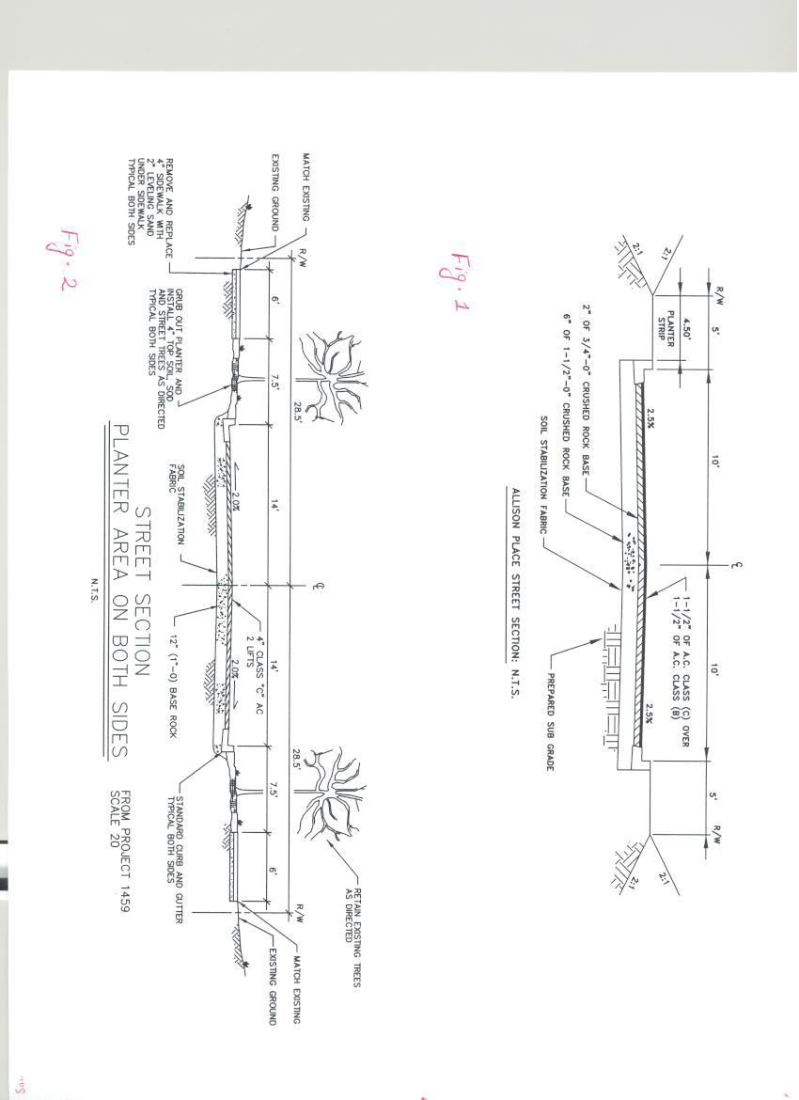
Assignment 7

Slide 8
ARC

Slide 9
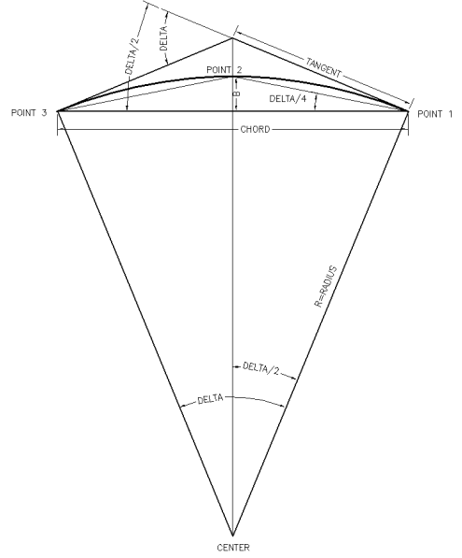

Slide 10
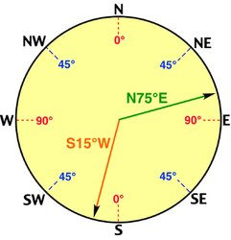
Bearing
Definition: Always an acute angle measured with its departure from the north or south line, with the east and west giving its direction of departure from the meridian.
Varies from 0 to 90 degrees, only.
Example: N 75° E, S 15° W, etc.

Slide 11
Map Scale
1” = 10’ 1”=20’ 1” = 50’
Map is drawn in 1” = 50’ What is drawing distance of 200 ft actual length?
Find Scale factor?
Scale factor is 600
Drawing distance = 200 * 12/600
Answer = 4”

Slide 12
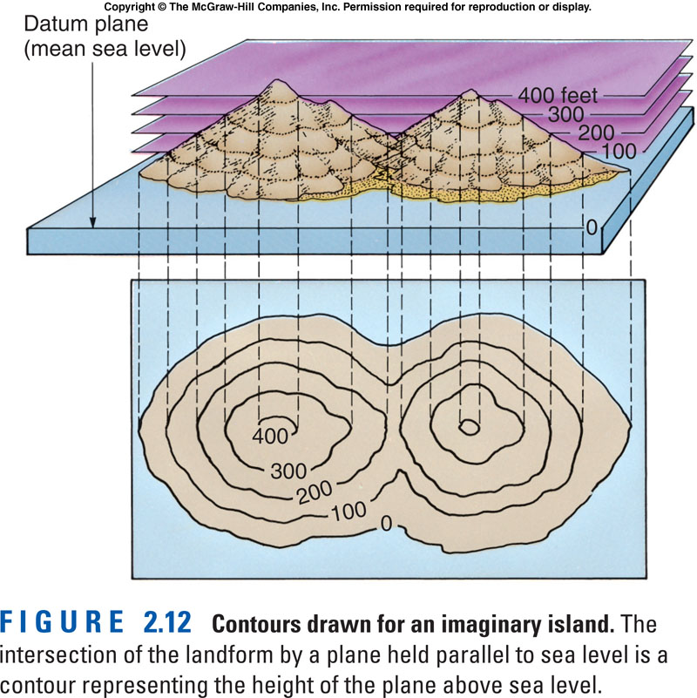
Contour map

Slide 13
Earthwork

Slide 14
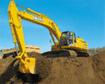
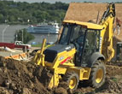
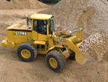
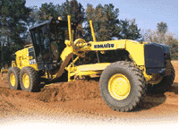
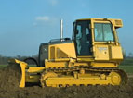
Excavation Equipment

Slide 15
Excavation Equipment
Scrappers (pans)
Trenchers
Boring/Tunneling
Motor Graders
Auto Graders
Compaction Equipment
Rollers & Tampers

Slide 16
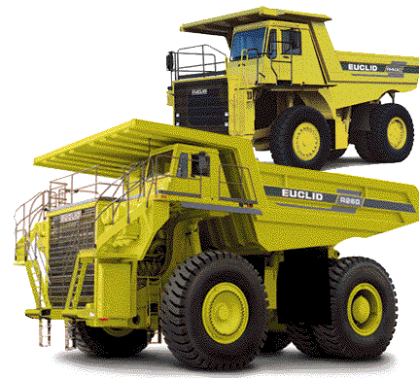
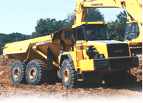
Hauling Equipment

Slide 17
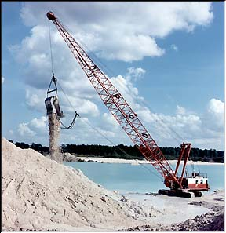
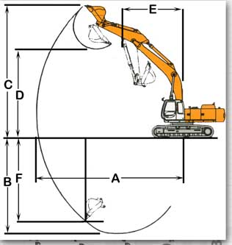
Excavation Equipment

Slide 18
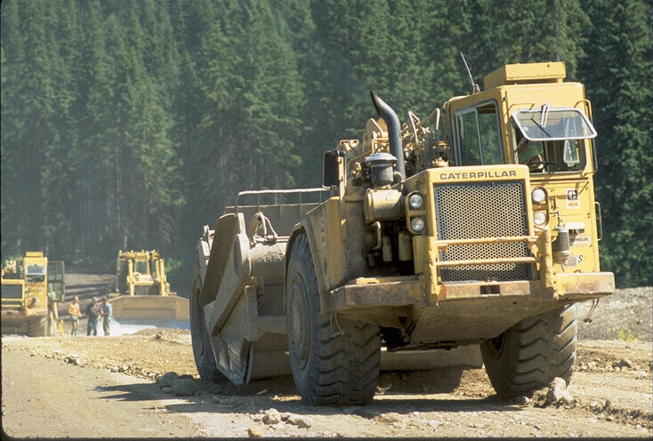
Excavation Equipment

Slide 19
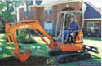
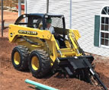
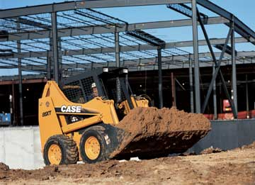
Excavation Equipment

Slide 20
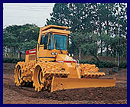
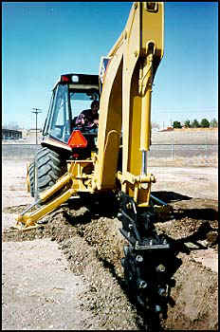
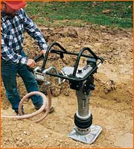
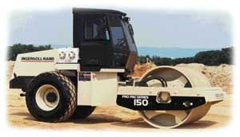
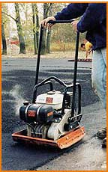
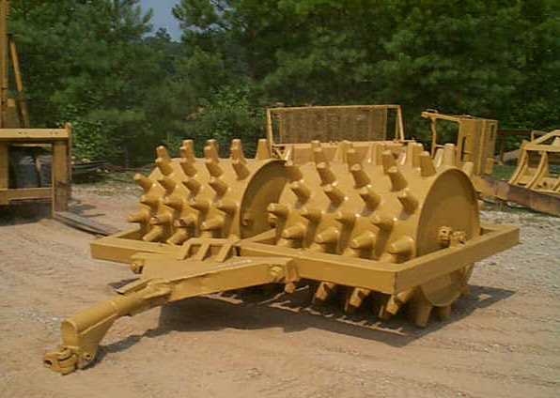
Compaction Equipment

Slide 21
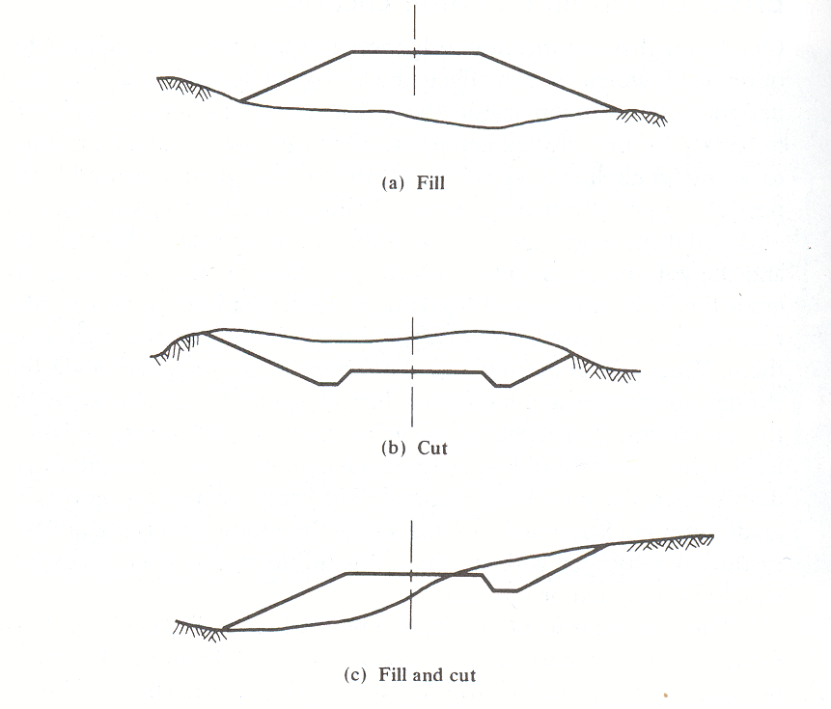
Source: Garber and Hoel, 2002

Slide 22
Computing Volume (Example)
Station 1:
Cut Area = 6 ft²
Fill Area = 29 ft²
Cut
Fill
Ground line

Slide 23
Computing Volume (Example)
Station 2:
Cut Area = 29 ft²
Fill Area = 5 ft²
Cut
Fill
Ground line

Slide 24
Angle of repose
What is angle of repose?

Slide 25
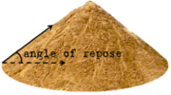
Angle of repose
An angle of repose of 2:1 means that every 2 ft of horizontal distance, the slope rises or drop 1ft vertically

