Slide 1
Civil Drafting Plot, Plat or Subdivision
Sanjeev Adhikari, PhD

Slide 2
Plot Plan (Subdivision Plan)
Arc
Bearing of Line

Slide 3
What is ARC?

Slide 4
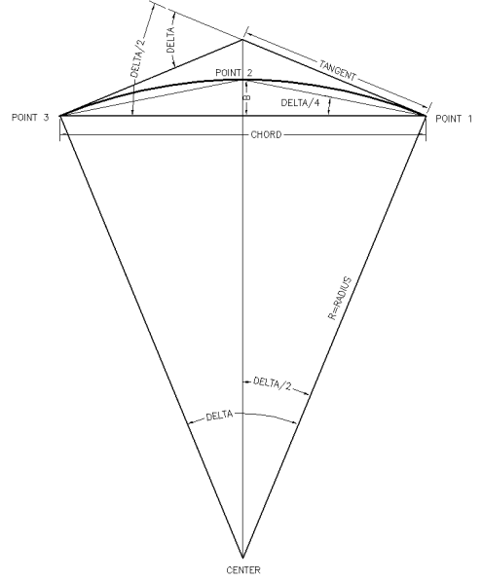

Slide 5
ARC: Different way of Drawing
Three Point
Start, Center, End
Start, Center, Angle
Start, Center, Length
Start, End, Direction
Start, End, Radius

Slide 6
Draw Arc from following informations
Radius, R = 24’
Length of Chord, L = 30.77’
Included Angle, Delta = 71 degree

Slide 7
Draw Arc from following informations
Radius, R = 10’
Length of Chord, L = 13.70’
Included Angle, Delta = 89 degree

Slide 8
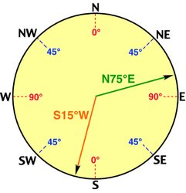
Bearing
Definition: Always an acute angle measured with its departure from the north or south line, with the east and west giving its direction of departure from the meridian.
Varies from 0 to 90 degrees, only.
Example: N 75° E, S 15° W, etc.

Slide 9
Draw Line from following information
Length, L = 112.93’
Direction = S 34˚09’22” W

Slide 10
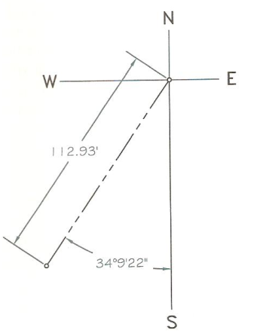

Slide 11
Now
Length = 112.93
Angle Counter clockwise = 270-34.156 = 235.84 @112.93<235.84 or @112.93<S34D09’22”W

Slide 12
Options
Make sure options: Angular Units: Decimal Counter clockwise Linear units: Decimal You can change options as your comfortable too

Slide 13
You can start Assignment 4
Posted on Blackboard
Due: Wednesday, February 23, 2011

Slide 14
Exam 1
Monday, February 28, 2011

