Slide 1
Civil Drafting
Sanjeev Adhikari, PhD

Slide 2
About Assignment 3 Drawing a Floor Plan of Small office
Wall drawing: Drawing Multiline – use parallel
Using Layers
Using Blocks

Slide 3
A+CAD
Some key points

Slide 4
Step-1
Use a parallel line for the outside walls (Using Three lines)
Use Trim commands

Slide 6
Step-2
Making Block with layer - Block of Outside Door - Block of Inside Door - Block of Window

Slide 7
Now You can draw block of inside door/outside door/window with block and layer

Slide 8
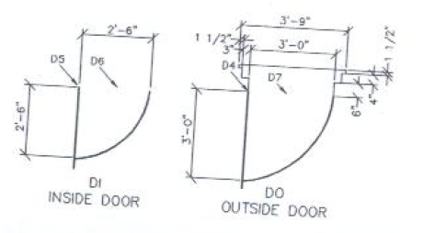
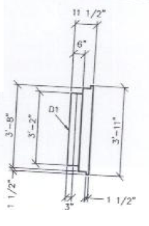
Block of inside door/outside door/window into plan
Window

Slide 9
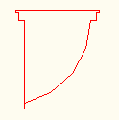
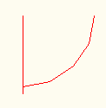
Outside door
Inside door
Window

Slide 10
Step-3
Insert Block into drawing

Slide 11
Now you can insert block of inside door/outside door/window into plan
Window

Slide 12
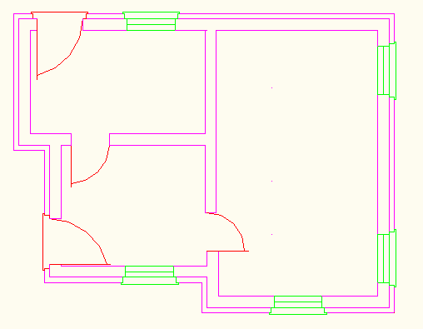

Slide 13
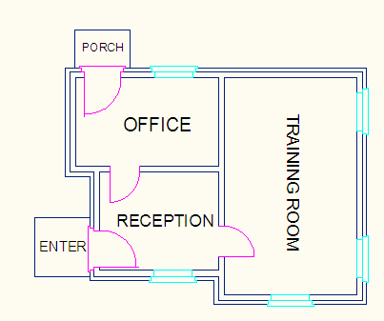

Slide 14
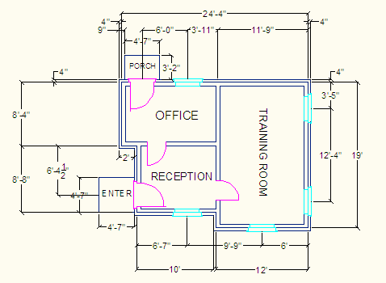

Slide 15
Step-3
Insert Furniture into drawing

Slide 17
How to get this?

Slide 18
Now you can insert Furniture into plan

Slide 19
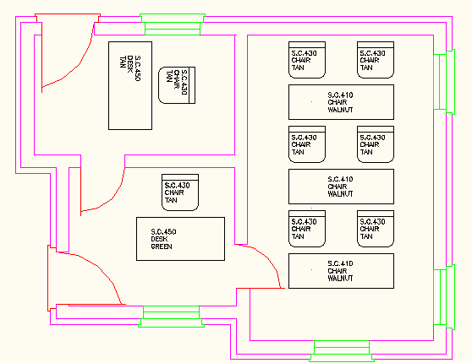

Slide 20
Step-4
Insert Furniture/ Computer/Telephone into drawing

Slide 21
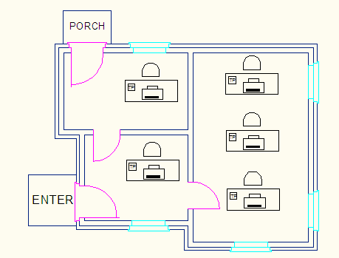

Slide 22
Your final drawing should be like this

Slide 23
